Slide 1
Read the riddles and guess the countries.
I AM ONE OF THE STATES IN THE USA. I HAVE 132 ISLANDS. THEY OFTEN CALL ME ‘THE ALOHA STATE’.
WHICH COUNTRY AM I?
I AM BOTH A CONTINENT AND A COUNTRY. LAND OF KOALAS AND KANGAROOS.
WHICH COUNTRY AM I?
I AM FAMOUS FOR MY BEAUTFUL COUNTRYSIDE. MY FLAG IS VERY SIMILAR TO THE AUSTRALIAN FLAG.
WHICH COUNTRY AM I?
HAWAII
AUSTRALIA
NEW ZEALAND

Slide 2


Hawaii Australia New Zealand
ACROSS CULTURES

Slide 3
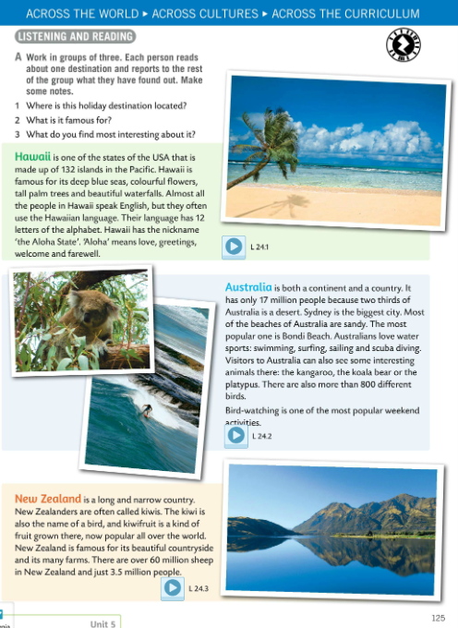
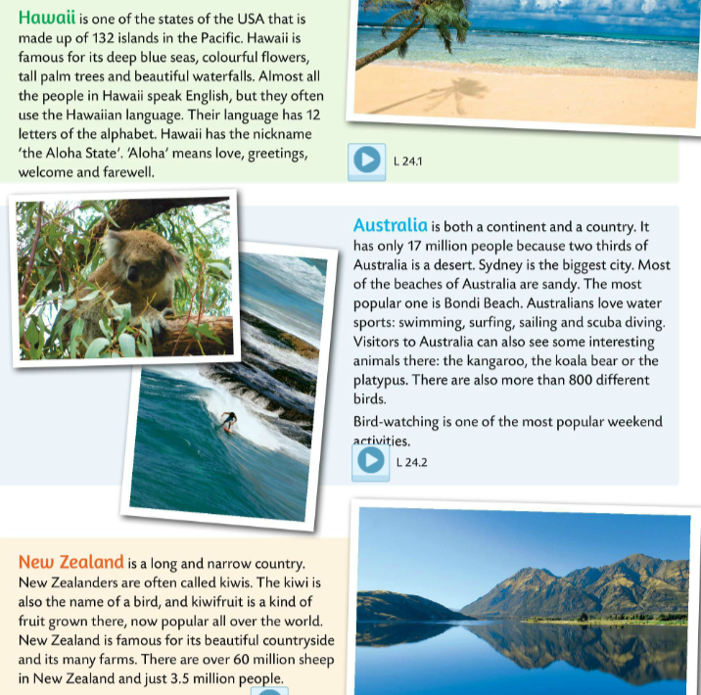
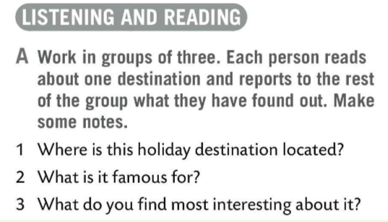

Work in groups of three. Each person reads about one destination and reports to the rest of the group. Make notes.
Answer questions in Task A.
Listen to the recordings and check your answers.
Speaking time!
Choose one country and say what you remember about it. Don’t use your notes.

Slide 4
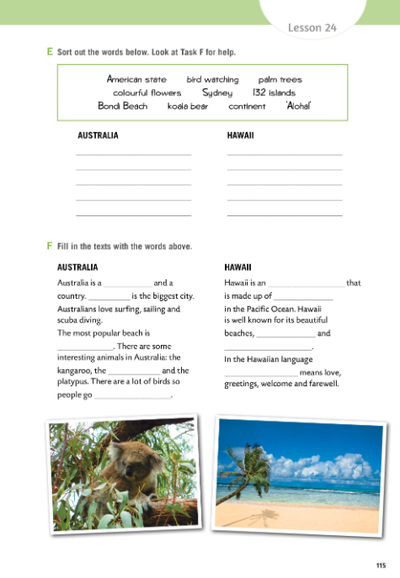

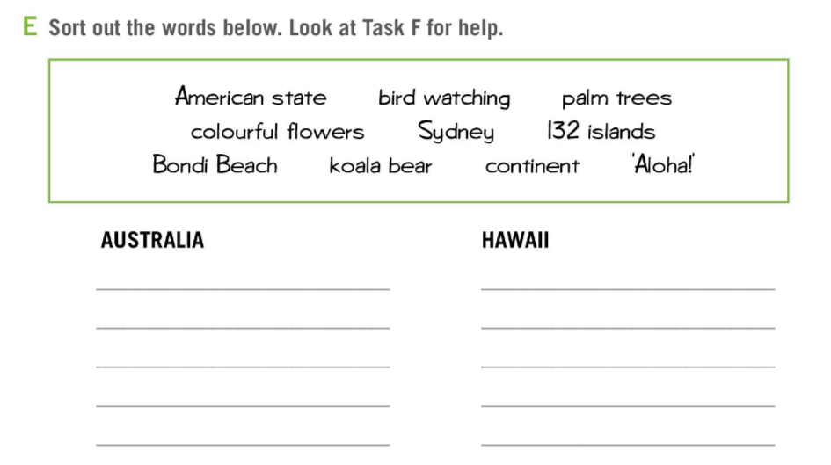
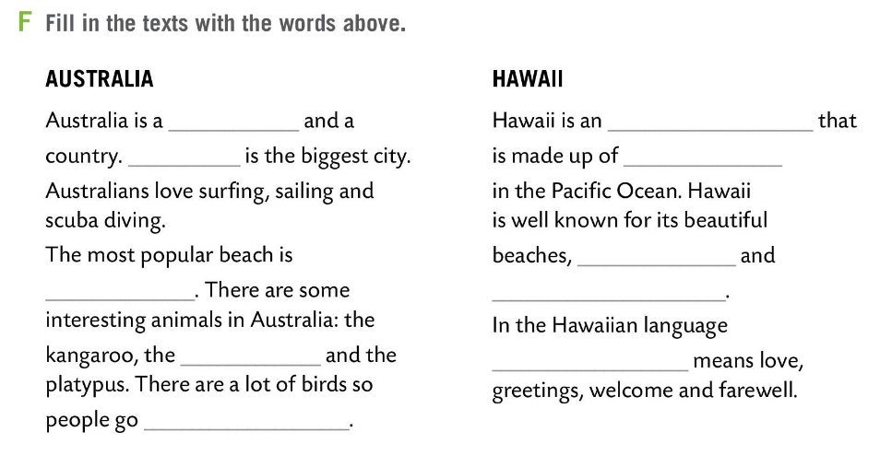
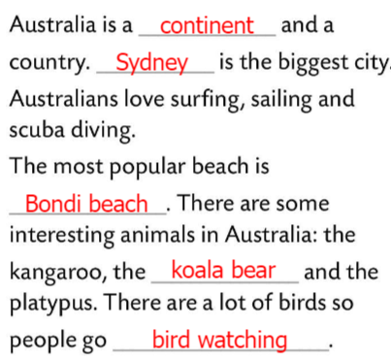
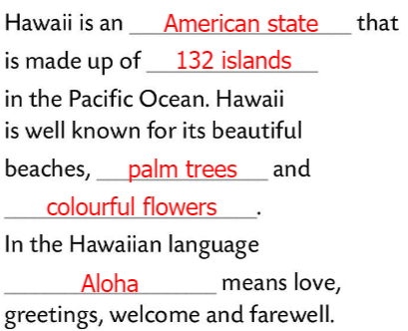
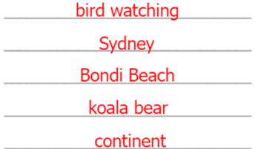
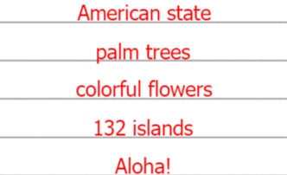
Workbook page 115.
Do Task E. Sort the words.
Look at Task F for help.
Check.
Fill in the texts in Task F with the words from task E.
Check.

Slide 5
Watch the videos.
New Zealand
Which country would you like to visit?
Why? Discuss in class.
Australia
CLASSROOM COMPETITION
form two to three groups
draw both the Australian and the New Zealand’s flag
the winner - group that finishes the first and draws the flags correctly
Choose a country and make a poster.
Hawaii

Slide 6
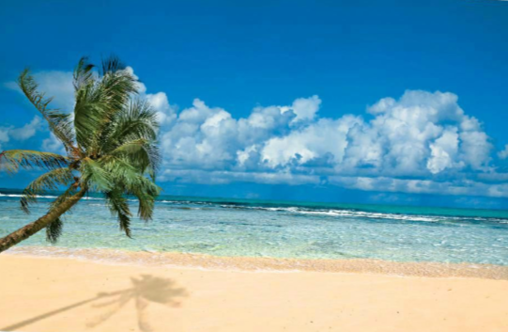
Drag and drop each item into the correct group.
https://wordwall.net/play/14286/823/662

